Slide 1
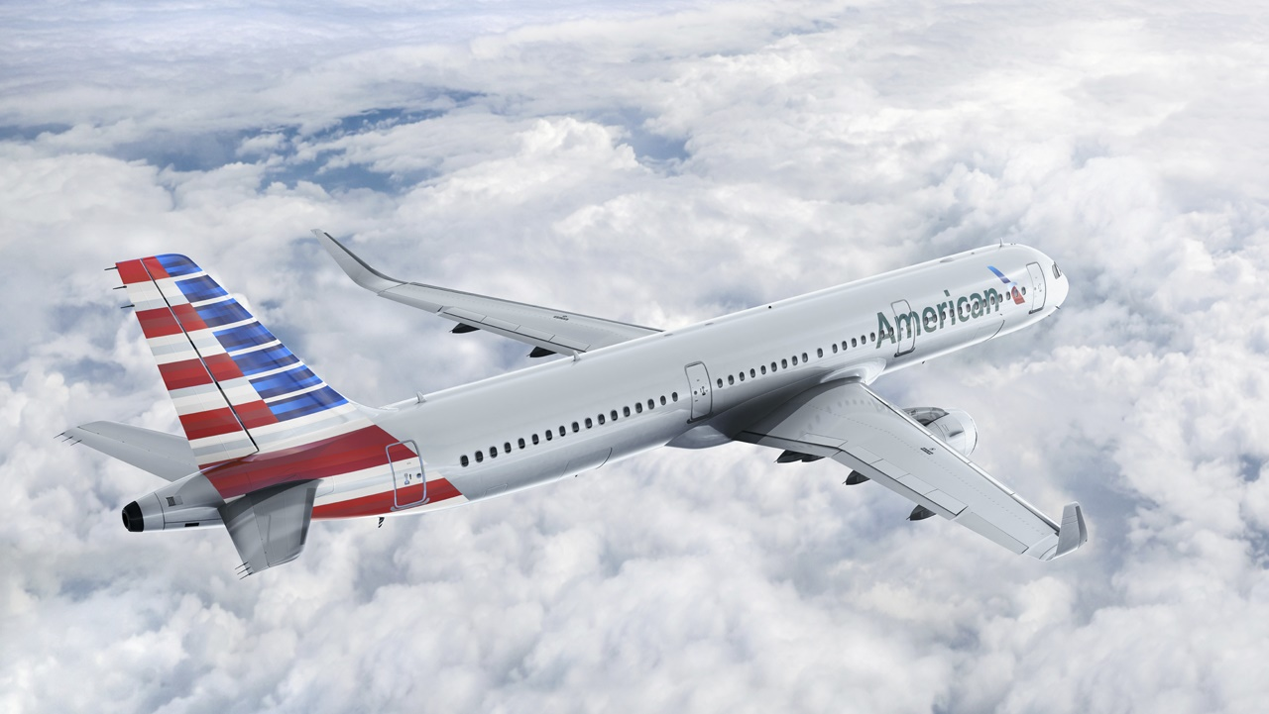
The ROAD to DevSecOps
Dan Glass
CISO @ American Airlines
@djglass
Notes:
Dan Glass
CISO at American Airlines
Sounds like a pretty cool job
I mostly look at spreadsheets

Slide 2
Founded 1926
115,000 employees
950 aircraft
350 airports
53 countries
4,500,000 flights
47,000,000 passengers
200,000,000,000 passenger miles
Notes:
We’re pretty big
…and there’s a lot of technology that makes all that magic happen

Slide 3
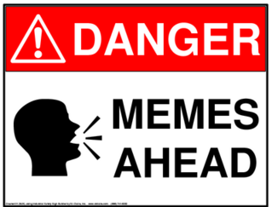
Notes:
If you’re looking to extract cool graphs, stats, or YML files… you’re out of luck
I think there’s something like 5 slides that aren’t memes.
Just be thankful – I’ll be done with this talk in about 30 minutes… my staff have to deal with me for 50 hours a week
This talk has three chapters:
Security Strategy
Enterprise Challenges
Opportunities (and more challenges)

Slide 4

Notes:
As mentioned, this is not a talk about tool chains, deployment patterns, or architectures
Which is good because…

Slide 5

Notes:
True story

Slide 6
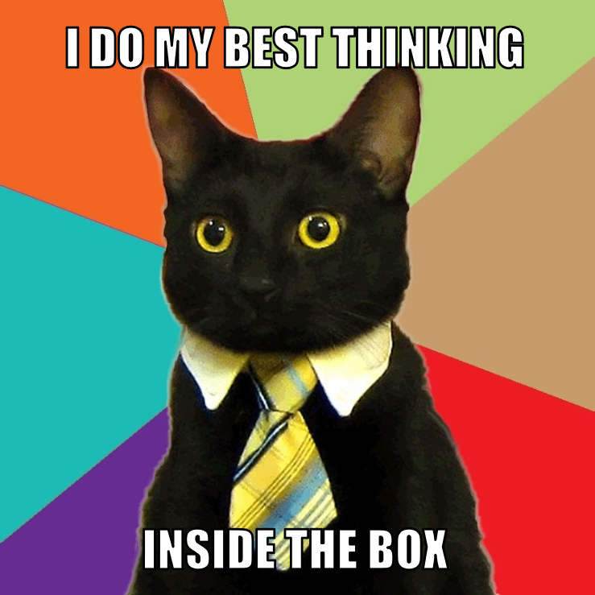
Notes:
This is a presentation how to enable a philosophy of protection that is in direct conflict with legacy controls, processes, funding, and culture
This isn’t about knife-edge transformation – this is about enabling the new mindset and functionality while maintaining legacy systems and processes
There are definitely some things that make airlines unique – but also some that make them just like any other large complex enterprise

Slide 7
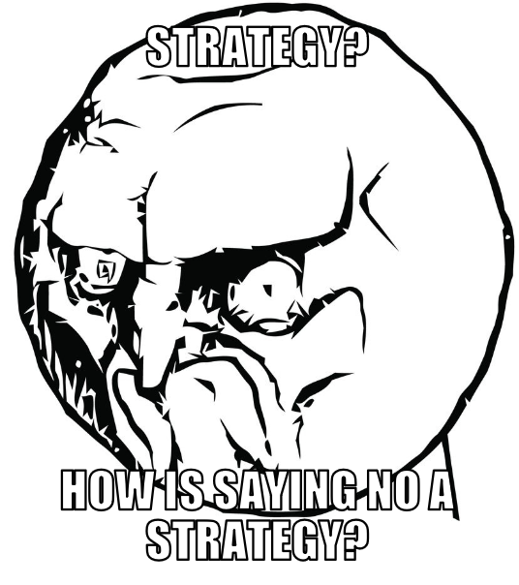
Notes:
I will share my overall Information Security strategy and the path we’re taking to balance new methods of deployment with the traditional ways of doing things

Slide 8
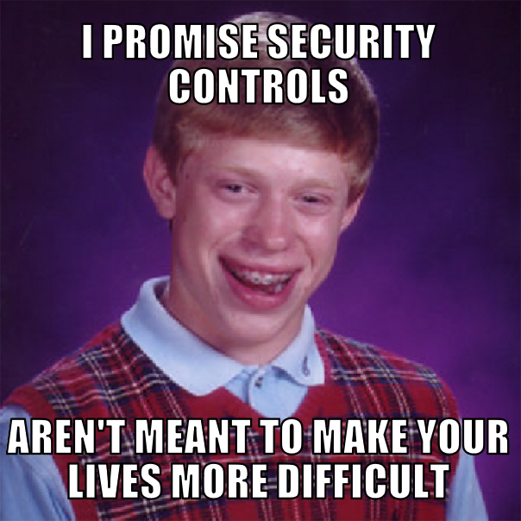
Notes:
I talk to a lot of my peers across many industry verticals – the challenges of running a large and complex IT organization are not unique to my company or aviation
If you work for a legacy company large or small you’ll recognize some of these challenges

Slide 9


Notes:
That being said, before we can discuss strategy we need to be able to deliver one…
Need a talented team of professionals
That believe in what they do and who they do it for
Leadership smart enough to know when to allow those talented team members to go do amazing things

Slide 10
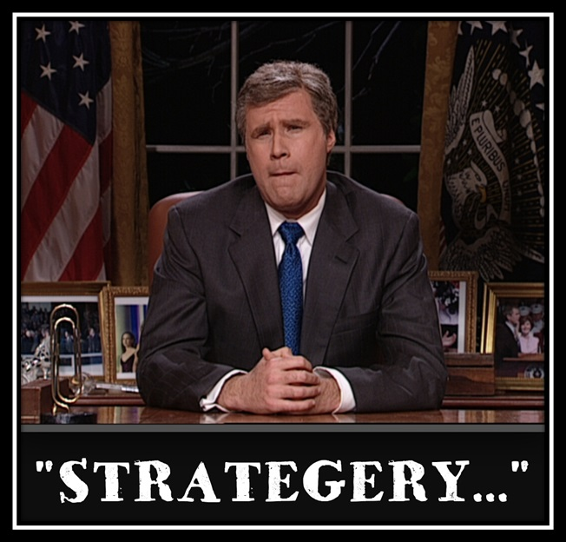
Notes:
Focuses on the basics of defense
It doesn’t depend on any specific technology, architecture, or process
Strategy easy to understand and durable
“control du jour” will easily fit within the strategy
carefully chosen words
Because words matter

Slide 11
Rugged Systems
Actionable Intelligence
Defensible Platforms
Operational Excellence
Notes:
Everything in an airline has to be an acronym
ROAD
Rugged Systems
Operational Excellence
Actionable Intelligence
Defensible Platforms
I will describe each briefly and give some examples of programs and services we use to achieve the strategy

Slide 12
Rugged Systems
Resilient
Tested
Adaptable
Notes:
We will aid the business to develop and maintain RUGGED SYSTEMS that can survive in hostile environments.
We will design these systems to be RESILIENT against attack.
We will ensure systems are ADAPTABLE to changes in environment.
We will ensure systems are TESTED repeatedly to ensure they meet enterprise standards.
Because the answer to any security question shouldn’t be “moar firewalls!”
First thing you need is an application security program that features:
Secure Coding standards
Automated code testing / analysis / reporting
Developer training / outreach / consulting
Build systems that are secure from the ground-up
Architectural guidance is key
Produce security “blueprints” for functional requirements
Help enable DevOps tool chain (automated scanning) but still support legacy SDLC, older programming languages, manual processes
The standards, testing, training must be flexible to work with your entire organization
Outreach to developers, management - understand focus, pressures, how Rugged fit into their lifecycle
Sell code quality, fewer defects, and make presence in their life as painless as possible
Be an ally not a roadblock

Slide 13
Reliable
Operational Excellence
Sustainable
Speed
Notes:
We will strive to maintain OPERATIONAL EXCELLENCE to meet the increasing demands of a dynamic organization.
We will build engagement and delivery processes to ensure RELIABLE services.
We will standardize procedures across services to create a SUSTAINABLE environment.
We will increase usage of automation and leveraged services to increase SPEED to market.
All about process
Centralized or federated, manual or automated
ingrained into culture or goal will be unobtainable
This is about those “blocking and tackling” tasks that are vital to the success of any information security and risk management program
Boring but important
Things like patching (yes, that’s still a thing)
Asset/configuration management
Change management/detection
Toughest parts of IT budget to defend and maintain

Slide 14
Actionable Intelligence
Correct
Meaningful
Relevant
Notes:
We will harvest, analyze, and rapidly convert large sets of data into ACTIONABLE INTELLIGENCE to enable quick decision-making.
We will perform regular data source hygiene to ensure the data are CORRECT.
We will ensure that data are MEANINGFUL by collecting the right data from the right systems.
We will perform analysis to ensure only RELEVANT information is communicated.
Visibility
running a 24x7x365 SOC
outsourcing to a third party
partnering with IT peers to share their
Maya story
Turning on the lights is not enough
invest in platforms that let you cull through vast amounts of data
invest in people to understand context and act on it appropriately
People > Tools

Slide 15
Defensible Platforms
Hardened
Survivable
Tested
Notes:
We will develop, deliver, and maintain DEFENSIBLE PLATFORMS that protect enterprise information resources.
We will develop common standards to ensure all platforms are HARDENED.
We will design our platforms to SURVIVE against sustained attack.
We will enable business activity by deploying EFFECTIVE defenses to mitigate malicious activity.
This is where folks like me are most comfortable
Design platforms secure from the ground up
Solid security architecture framework is vital to this mission
Controls are being applied as consistently as possible
Many layers of controls throughout network / ecosystem
Network
Platform
Identity
Access

Slide 16
Identify
Protect
Detect
Recover
Respond
Rugged Systems
Operational Excellence
Defensible Platforms
Actionable Intelligence
Notes:
The strategy covers all aspects of an information security program
It even aligns to the NIST CSF (whew!)
Identify
Protect
Detect
Respond
Recover

Slide 17

Notes:
What are some of the airline-specific challenges?
There is the aircraft itself
Long half-life
Aircraft can be in service over 30 years

Slide 18

Notes:
Here you can see inside one of our cockpits
Onboard IT systems are updated often and can be replaced but at great cost to airline
Therefore, design issues that require modifying hardware are problematic – measure twice cut once is a mantra we repeat often when referring to systems that touch aircraft
There are manual processes that deploy software to digitally enabled aircraft
These processes rely heavily on separation of duties, integrity checks, and physical access – and they work pretty darn well
The concept of safety is ingrained deep into these processes and technologies
In other words, these processes dictate the flow of updates from manufacturers, integrators, and internal IT to the aircraft

Slide 19
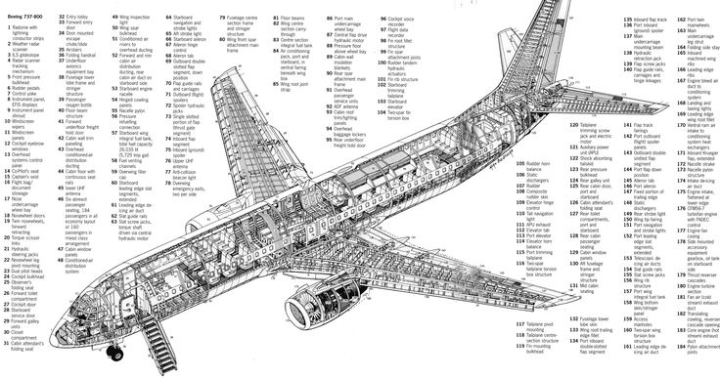
Notes:
Sometimes slow is necessary and even desired – the concept of “fail fast” doesn’t really work in this case
It is incredibly expensive for the airline to make changes to an aircraft so utmost care must be given to ensure we minimize impact to the fleet
For example, when we want to update something like a certificate revocation list we have to either pull an aircraft out of service or wait until it’s scheduled “deep” maintenance check (which can be months off)
So, therefore if there was an error in the update we would in effect ground our entire e-enabled fleet until maintenance & engineering had a chance to touch each and every aircraft before they could be entered back into service
If I sound repetitive it’s because of how important this point is – mistakes are extremely costly and disruptive

Slide 20

Notes:
Now let’s talk about some of the issues we face in a large complex enterprise
This is not one of our new planes – but a boy can dream…

Slide 21
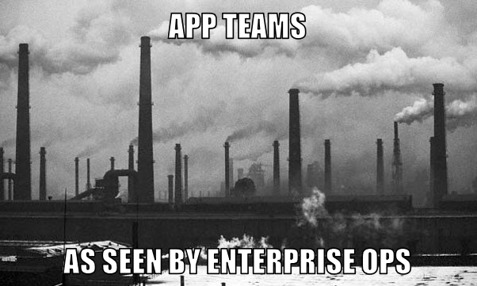
Notes:
IT groups align to business units
Business units have unique needs that require unique solutions and expertise - one size doesn't fit all
This creates smokestacks that silo expertise, systems, and delivery away from each other
This is efficient for the needs of the business - but creates issues for central enterprise services like security
One of the negative aspects of smokestacks is that knowledge is often trapped in chimney
Common practices, domain knowledge, and lessons learned aren't communicated

Slide 22
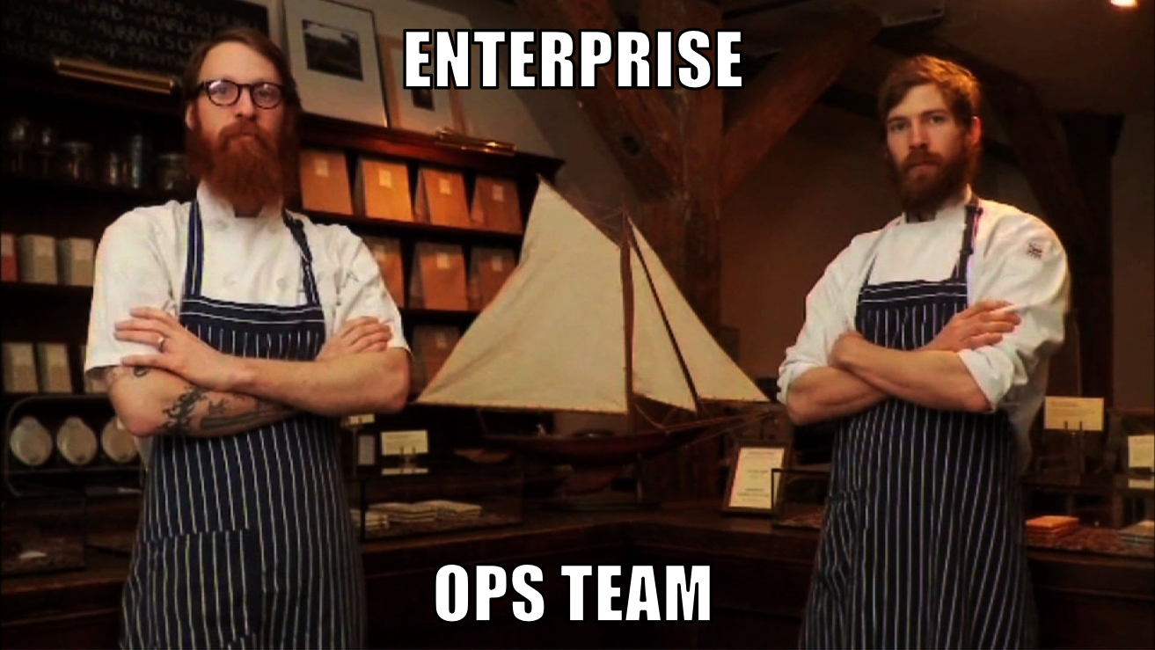
Notes:
I know Brooklyn thinks it has the market cornered on “hipster”
But we have artisanal, local, organic, silicon-based systems that are hand-crafted with love for each deployment and are built to last
So, even with security baselines, configuration standards, and build standards systems are still hand-crafted with love
Virtualization and cloud were supposed to fix this problem
However, these technologies bring raw capabilities but lack the processes and culture to make them effective by themselves

Slide 23
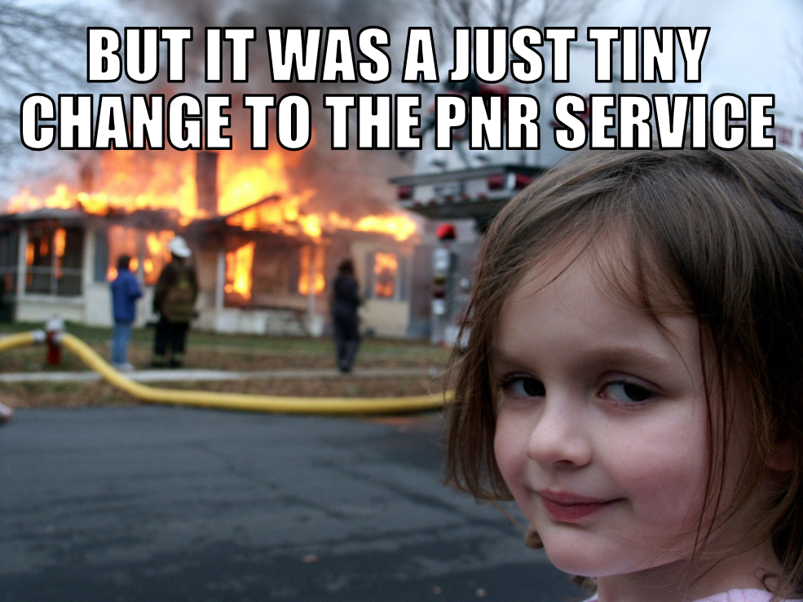
Notes:
Literally thousands of systems, subsystems, and processes run an airline day-to-day
These systems have high levels of dependence on each other
This can occur via hardcoding parameters or locking in on a certain version of vendor software
We end up with systems with thousands of hard dependencies both upstream and downstream
As you can guess the stack becomes extremely brittle and so you hear “OMFG DON’T TOUCH ANYTHING!”
This issue slows planning, development, testing, and deployment

Slide 24

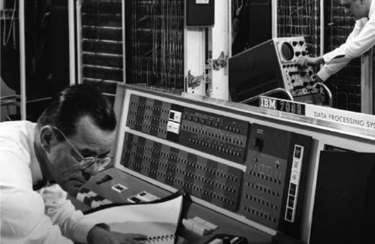


Notes:
Many systems have been built over the years that do their job perfectly well and don't change much
Core airline systems pre-date TCP/IP and Nixon as POTUS
Obviously many things have been modernized (but we still have TELETYPE)
We also have over 1,100 modern applications that take the data from those core mainframe systems and make magic happen every day

Slide 25
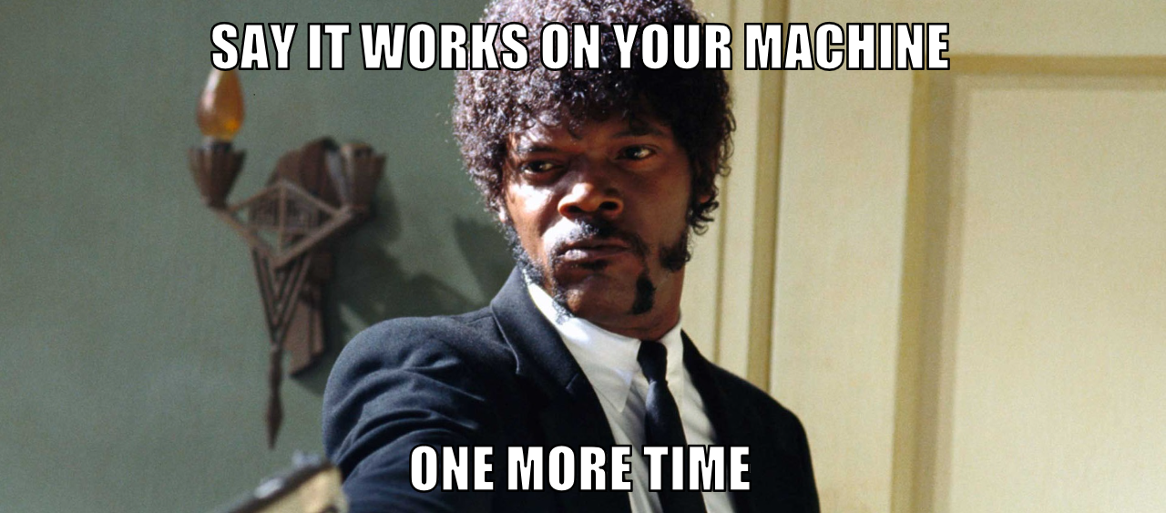
Notes:
None of these systems make a company inherently insecure or unstable
In some limited cases these problems can be seen as a benefit - processes that ensure errors are eliminated before they get into a production system
However, they do make them slow to deliver new functionality, fix problems, or pivot in new directions

Slide 26

Notes:
Security is ready to take the red pill
DevOps solves some of the issues that legacy IT faces
Automated configuration, testing, and deployment would help the airline get its products and services to customers and employees faster
Immutable infrastructure is awesome
Automated security scanning? Bitchin'
Nobody gets interactive access to prod? OMG WHERE DO I SIGN UP?
But all this still creates many new... ahem "opportunities" for infosec
We still have long lead times and tons of WIP due to rigid legacy operational processes, tightly coupled systems, and more neck than bottle at times
An application team may have 500 developers all wanting to push code but if the one gal that knows the build process inside and out goes on vacation…
And we still have those pesky firewalls…

Slide 27

Notes:
But it's such a different paradigm it's tough to explain to team
Where do we start?
Lean? It’s a lot of work to explain how we can apply Toyota’s manufacturing method to what we do – everyone is busy and not everyone reads 2-3 books a month
Agile? Mature agile teams at AA but not everywhere due to organizational and cultural challenges – as will be explained later
DevOps? If you don’t understand Lean or Agile DevOps just looks like a set of tools to wrap manual processes and oversight to
In other words – if you don’t get why lean thinking, agile development, and devops delivery works… you’re doomed to fail

Slide 28
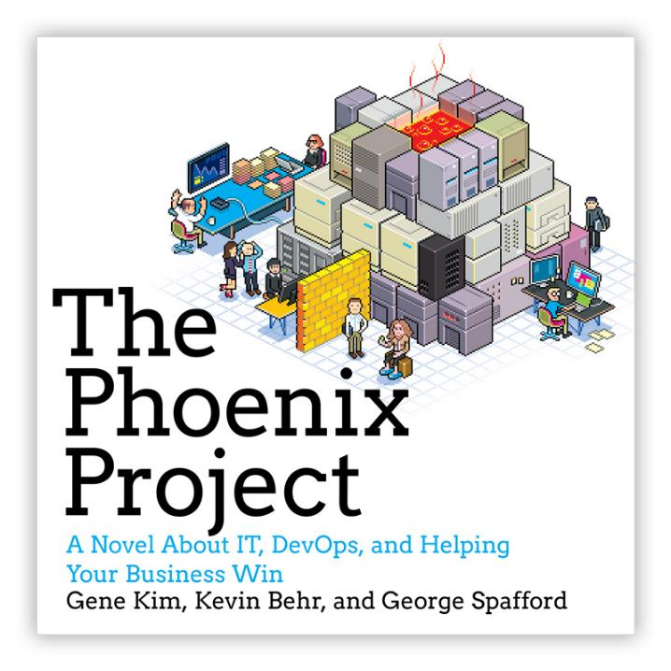
Notes:
Phoenix Project is a great start (it’s the book that started my journey a few years ago followed quickly by “The Goal” and “Continuous Delivery”
You must be ready to follow it up with discussion and support to change things – otherwise people will remember the first half (all the problems) but forget the lessons learned in the second half (Lean, Agile, DevOps).
Requires leadership buy-in to ensure culture change

Slide 29

Notes:
To drive the point home and give us some perspective about how this ain’t easy: Netflix recently shared that they finally migrated 100% of their legacy operations to AWS
It took Netflix 7 years to get there. I have no doubt they could have done it sooner if they didn’t have a business to grow and run
Most IT organizations don’t have Netflix’s business model, flexibility, or commitment to the model – this “all in” approach is awe-inspiring but if it took Netflix 7 years… how long will it take us?
So the challenge is:
We want to enable/encourage DevOps culture, processes, and tools
We must maintain/improve legacy protection
We must continually adapt to emerging threats
Oh and we have to keep costs in check – we don’t all get unlimited budgets
Basically we want magic
But I believe in magic ☺

Slide 30
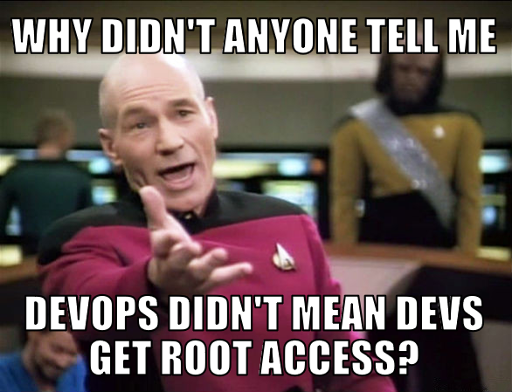
Notes:
Embrace DevOps but make sure to keep giving legacy a squeeze now and then
New is exciting and sexy but if you don’t account for the existing systems/issues you’ll find yourself with decaying infrastructure and you’ll be back to fighting fires instead of delivering value (remember Netflix took 7 years!)
In other words, don't replace one set of problems with another whole new set of worse problems

Slide 31
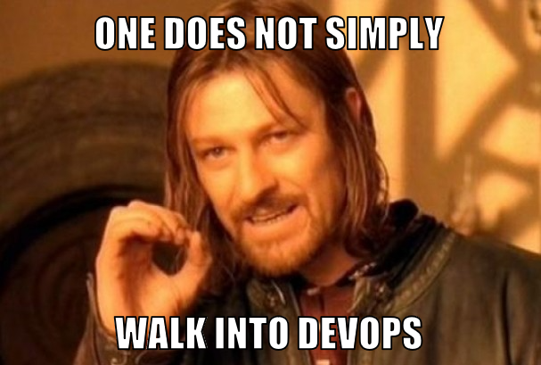
Notes:
Automate what you can; solid process for the rest
Encourage automation but understand that many see automation as a threat to their livelihood so prepare to meet resistance here
This is probably the toughest part of the culture shift outside the whole “it’s new and different” thing

Slide 32
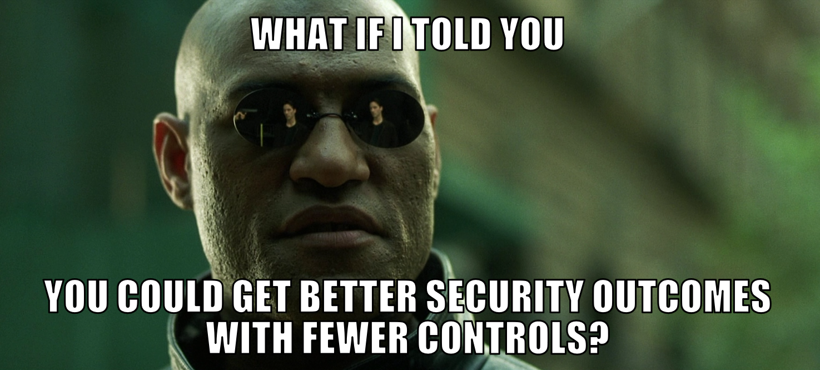
Notes:
Automated controls increase security, accountability, and consistency
Therefore, certain processes and controls can be shed if devops is adopted

Slide 33
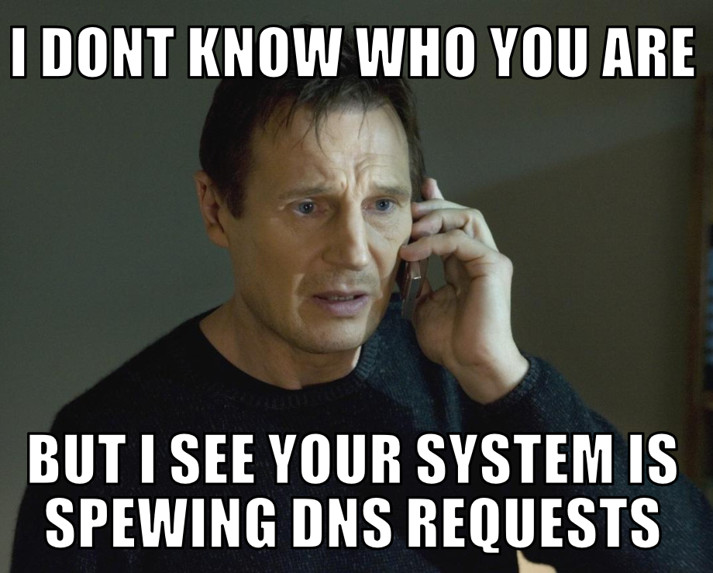
Notes:
DevOps toolchain can increase visibility
This visibility can ensure ops/secops can jump on problems quickly

Slide 34
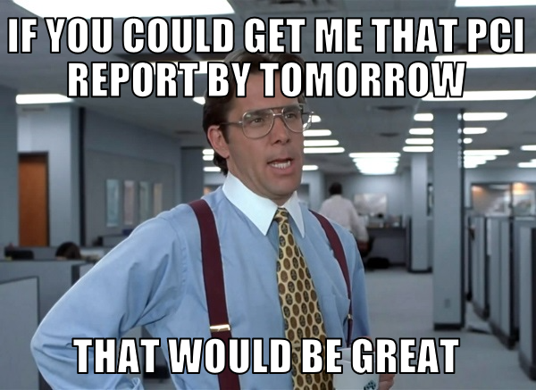
Notes:
Remember, compliance is still a thing
Explaining devsecops to a QSA or auditor isn't as easy as you think
Eventually they nod their heads
Winning!!!
Then they’ll say
“but PCI DSS x.x.x says and I quote..."

Slide 35
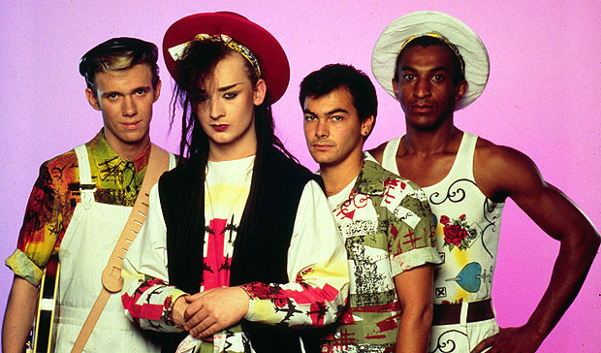
Notes:
Culture lets us experiment with new tools, tools enables process improvements, process improvements improves the culture, culture enables further experimentation in tooling
Without all three you’re doomed to repeat past behavior

Slide 36
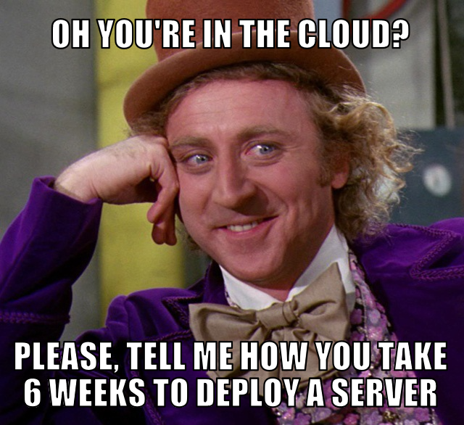
Notes:
Be wary here – let me take a moment to recount how to make something cool suck
When we (AA) first deployed to cloud in early 2010
Security was actually a champion of the concept and pushed for it - the nirvana you all are achieving today
However, when we designed the security controls we layered in cool bleeding edge security tech but continued to use our legacy processes
Therefore, we ended up with a bunch of systems in the “cloud” but in reality it was just another data center deployment from a speed perspective (outside spinning up the original VM)
Obviously this was a long time ago and we’ve matured
But the lesson still stands out as we approach devops and whatever is next

Slide 37
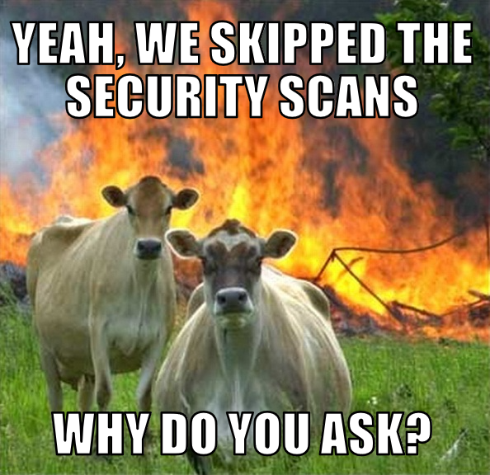
Notes:
Trust, but verify
enable dev, eng, ops to do their jobs quickly but put in checks to ensure security isn’t skipped
Make it okay to push to prod w/ security vulns (within reason) as long as the remaining bugs are placed in the backlog
If they do skip informally and nicely ask why… maybe your scanning engine sucks
Most people bypass or avoid security because we’re slow and always a step behind

Slide 38

Notes:
Build partnerships - security isn't just security's problem
Must work between silos – don’t expect stovepipes to magically break down
In fact, the turf wars may get worse as people find religion about tool chain design, tools, and methodologies
Their motivations haven’t shifted nor has pressures to deliver
In order for you to succeed you must be empathetic, adaptable, and knowingly respect boundaries others draw between themselves and other teams

Slide 39
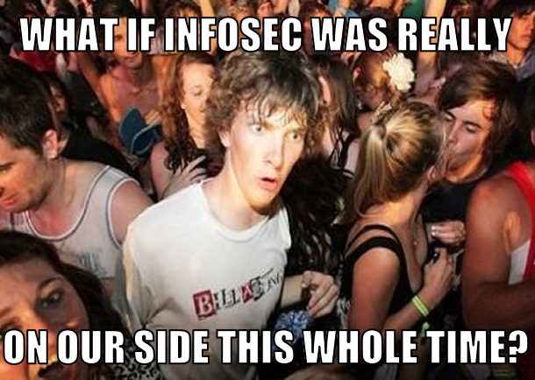
Notes:
Security needs to be transparent and open
There really isn’t any secret sauce to what we do – we deliver functionality and value to the business
Share successes and failures with IT peers, let them know you face the same exact issues they do when it comes to delivery and service management

Slide 40
Notes:
Here is my request of the devops community
understand that your security team has a different set of pressures and goals
Explain what you’re doing, why, and how there is mutual benefit
Be patient with us – we’re used to being hit upon the head

Slide 41
thanks!
Notes:
Thank you, I really hope this wasn’t a waste of your time

